Slide 1
Self Introduction

Slide 2
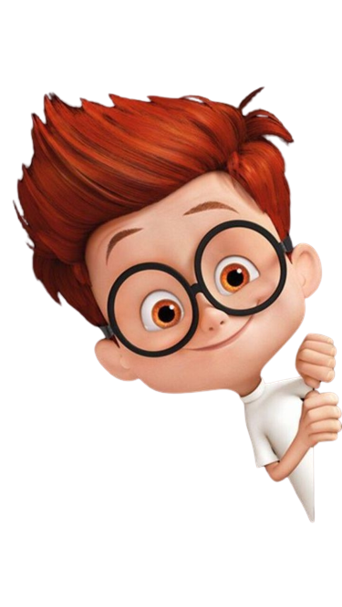
About Me…
Myself Rutvik Joshi
I am from Bhavnagar
Currently living in Ahmedabad

Slide 3

Education Qualification
10th
12th
Bachelor of computer application
Software testing course (pursuing)

Slide 4
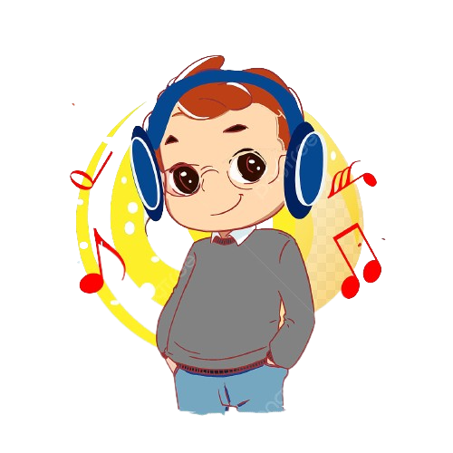
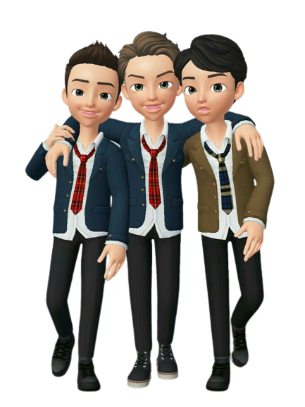
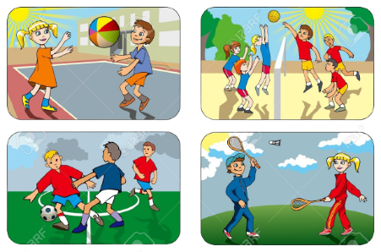
hobbies
Listening music
Time spend with friends
Playing outdoor games

Slide 5
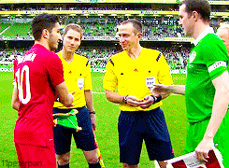
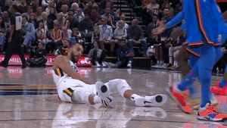
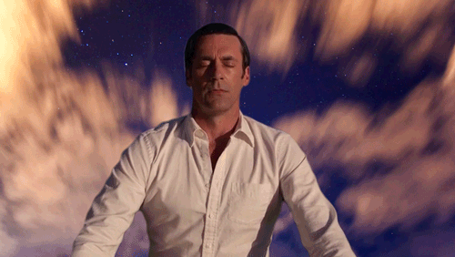
I am….
Friendly person
Helpful person
Calm person

Slide 6

strength
weakness
Time management skill
Accept changes
honest
Don’t say no
Self criticism
sensitive

Slide 7

I love
I hate
My self
My family & friends
Watching movies
Rudeness
Do nothing
Violence
Fake person

Slide 8


